Slide 1

Lecture 1
CS 161 Design and Analysis of Algorithms
Ioannis Panageas

Slide 2
Course staff
Instructor: Ioannis Panageas
Email: ipanagea at ics dot uci dot edu
Office hours: Wednesday 2:00-4:00pm (zoom)
Head TA: Navin Velazco (any requests)
Email: nvelazco at uci dot edu
Office hours: Monday 12:00-1:00pm (zoom)
TAs:
Parnian Shahkar (shahkarp at uci dot edu)
Office hours: Friday 5:00-6:00pm (zoom)
Nikolas Patris (npatris at uci dot edu)
Office hours: Wednesday 1:00-2:00pm (zoom)
Stelios Stavroulakis (sstavrou at uci dot edu)
Office hours: Wednesday 11:00-12:00pm (zoom)

Slide 3
Course material
https://piazza.com/uci/spring2023/cs161
We will use canvas for announcements. Slide materials will be posted on
https://panageas.github.io/algo2024.html
We will use gradescope for posting homeworks and grading.
We will be using Edstem for questions of general interest about the course material, the homework, and the tests
https://edstem.org/us/courses/57731/discussion/
Required Textbook
Algorithm Design and Applications, by M. T. Goodrich and R. Tamassia.
Recommended Textbook
Introduction to Algorithms by Thomas H. Cormen, Charles E. Leiserson, Ronald L. Rivest, and Clifford Stein.

Slide 4
Grading
Homeworks: 20%
There will be given 4 Homeworks to solve (+5% bonus for Homework 5).
Midterms: 20+20+20%
There will be given 3 midterms, on Tuesdays of week 4,6 and 9. Each midterm will contain topics from previous weeks.
Final : 20%
Material from all weeks (except last week).
+1% for Course Evaluation

Slide 5
Letter Grades
Not a straight scale nor straight curve
90% and up guaranteed some sort of A or A-
80% and up guaranteed at least B-
70% and up guaranteed at least C-
Design and Analysis of Algorithms

Slide 6
Submitting Assignments
Written assignments in Gradescope
Must be legible
If you have messy handwriting, type your homework!
Bonus 5% for Homework 5!
Must be on-time.
Deadline: Fridays 23:59pm (see syllabus)
Programming assignments optional in Gradescope
Code must be in python and need to pass test cases
Design and Analysis of Algorithms

Slide 7
Exam Dates and Rules
The exams are held on the days listed (syllabus)
See policy in syllabus, no makeup exams
Exams will not be excused for reasons within your control.
If there is a valid reason (needs approval from instructor) for missing an exam, the grade will be split equally among the other components.

Slide 8
Academic Integrity Policy
If you need help, see:
Ioannis
TAs
Plagiarism risks an F in the class and more.
The following are examples of not okay:
Chegg GeeksForGeeks
CourseHero Quora
StackOverflow Github (generally)
Chatgpt or related platform
Design and Analysis of Algorithms

Slide 9
Collaboration with classmates
You can discuss some things freely with others:
What a problem is asking
How to do a non-homework or non-exam problem
How something from lecture worked
You should never:
Show your homework assignment to someone else
Write your solutions from notes taken outside lecture / discussion
Seek homework solutions from outside sources -- especially online!
Tell a student specifically how to solve a homework problem
Penalty for academic dishonesty: F in the course.
Design and Analysis of Algorithms

Slide 10
To-Do This Week
Read the syllabus
Treat it as though it’s a reading assignment.
Main document plus associated policy documents
Review Prerequisites
Help is available all week, including at all discussion sections
Design and Analysis of Algorithms
Notes:
Change this to reflect the Winter 2022 situation

Slide 11

What is algorithm
Algorithm is a procedure for solving a task
e.g. how do you sort a cart of books in increasing order of the volume number? (i.e. volume 1, volume 2, volume 3….)
Bad algorithm: compare all books, put smallest volume in the beginning and repeat.
Clever algorithm: divide the cart into two, sort the first half, sort the second half, merge them.
Design and Analysis of Algorithms

Slide 12
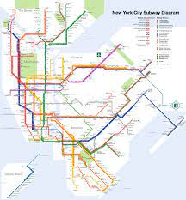
What is algorithm
Algorithm is a procedure for solving a task
e.g. How to find the best travelling time between from a station to any other station?
Bad algorithm: manually find the travelling between each station.
Clever algorithm: just record the travelling time between consecutive stations, then use the Dijkstra shortest path algorithm.
Design and Analysis of Algorithms

Slide 13

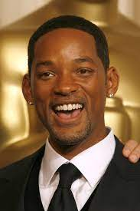


Case study I: Finding a Celebrity
Since coming to UC Irvine, has anyone met a celebrity?
Design and Analysis of Algorithms

Slide 14
What is a celebrity?
Within a group of people G, we say a person p is a celebrity (famous) if:
Everyone knows who p is (celebrities must be known by everyone)
Person p does not know who anyone else is
Goal: Find a celebrity from G if there exists one.
Design and Analysis of Algorithms

Slide 15
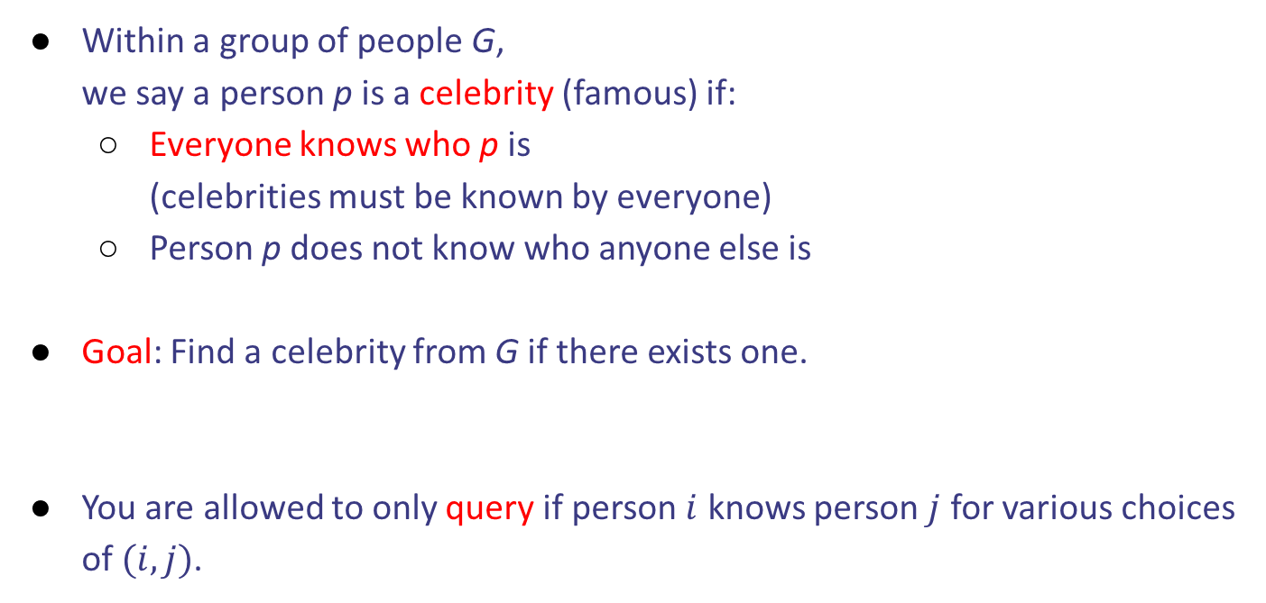
What is a celebrity?
Within a group of people G, we say a person p is a celebrity (famous) if:
Everyone knows who p is (celebrities must be known by everyone)
Person p does not know who anyone else is
Goal: Find a celebrity from G if there exists one.
You are allowed to only query if person $i$ knows person $j$ for various choices of $(i,j)$.
Design and Analysis of Algorithms

Slide 16
Brute force approach
Given a person p we want to check if it is a celebrity
How efficiently can I check if person p is a celebrity? # of queries
Design and Analysis of Algorithms

Slide 17
Brute force approach
Given a person p we want to check if it is a celebrity
How efficiently can I check if person p is a celebrity? # of queries
Query all other persons if they know p and also if p does not know them.
Design and Analysis of Algorithms

Slide 18
Brute force approach
Given a person p we want to check if it is a celebrity
How efficiently can I check if person p is a celebrity? # of queries
Query all other persons if they know p and also if p does not know them.
Design and Analysis of Algorithms

Slide 19
Brute force approach
Given a person p we want to check if it is a celebrity
How efficiently can I check if person p is a celebrity? # of queries
Query all other persons if they know p and also if p does not know them.
We have to do the above for all possible persons p.
Design and Analysis of Algorithms

Slide 20
Brute force approach
Given a person p we want to check if it is a celebrity
How efficiently can I check if person p is a celebrity? # of queries
Query all other persons if they know p and also if p does not know them.
We have to do the above for all possible persons p.
Design and Analysis of Algorithms

Slide 21
Brute force approach
Given a person p we want to check if it is a celebrity
How efficiently can I check if person p is a celebrity? # of queries
Query all other persons if they know p and also if p does not know them.
We have to do the above for all possible persons p.
Can we do better?
Design and Analysis of Algorithms

Slide 22
Faster approach
Put all the members in a list (arbitrary order)
Pick the first two members of the list, let p, q.
Query if p knows q.
Design and Analysis of Algorithms

Slide 23
Faster approach
Put all the members in a list (arbitrary order)
Pick the first two members of the list, let p, q.
Query if p knows q.
2 Cases:
p knows q. Then p is not a celebrity (remove p from the list).
p does not know q. Then q is not a celebrity (remove q from the list).
Design and Analysis of Algorithms

Slide 24
Faster approach
Put all the members in a list (arbitrary order)
Pick the first two members of the list, let p, q.
Query if p knows q.
2 Cases:
p knows q. Then p is not a celebrity (remove p from the list).
p does not know q. Then q is not a celebrity (remove q from the list).
Repeat the above process. At every iterate, we remove one person.
Design and Analysis of Algorithms

Slide 25
Faster approach
Put all the members in a list (arbitrary order)
Pick the first two members of the list, let p, q.
Query if p knows q.
Repeat the above process. At every iterate, we remove one person.
Check if this remaining person is a celebrity.
Design and Analysis of Algorithms

Slide 26
Faster approach
Put all the members in a list (arbitrary order)
Pick the first two members of the list, let p, q.
Query if p knows q.
Repeat the above process. At every iterate, we remove one person.
Check if this remaining person is a celebrity. Why do you need to check?
Design and Analysis of Algorithms

Slide 27
Faster approach
Put all the members in a list (arbitrary order)
Pick the first two members of the list, let p, q.
Query if p knows q.
Repeat the above process. At every iterate, we remove one person.
Check if this remaining person is a celebrity. Why do you need to check?
Design and Analysis of Algorithms

Slide 28

Case study II: Finding the heaviest and lightest item
We are given a set of n items of different weights: $x_{1}, x_{2}, …, x_{n}$
Goal: Find the heaviest and the lightest item.
Design and Analysis of Algorithms

Slide 29
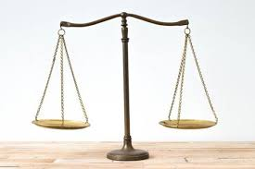

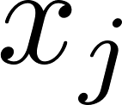
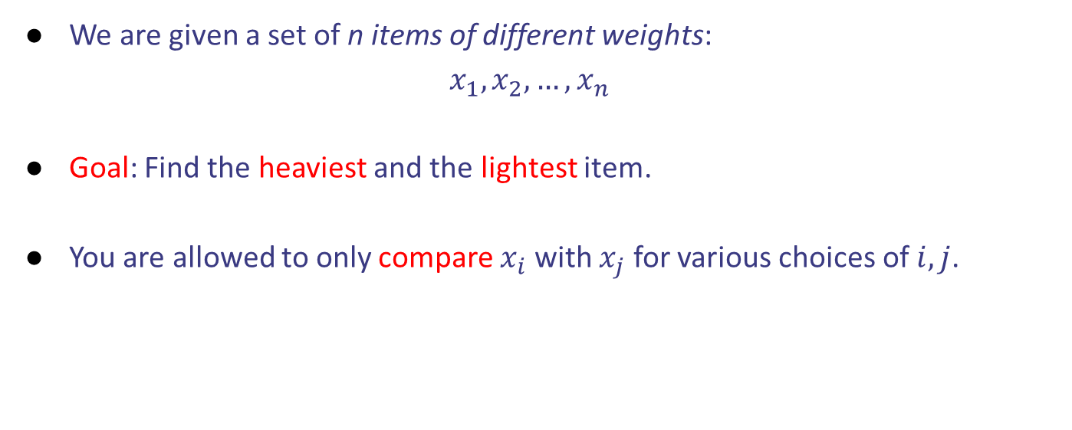
Case study II: Finding the heaviest and lightest item
We are given a set of n items of different weights: $x_{1}, x_{2}, …, x_{n}$
Goal: Find the heaviest and the lightest item.
You are allowed to only compare $x_{i}$ with $x_{j}$ for various choices of $i,j$.
Design and Analysis of Algorithms

Slide 30

Brute force approach
Find the heaviest item among $x_{1}, x_{2}, …, x_{n}$. How many comparisons?
Design and Analysis of Algorithms

Slide 31

Brute force approach
Find the heaviest item among $x_{1}, x_{2}, …, x_{n}$. $n−1$
Design and Analysis of Algorithms

Slide 32

Brute force approach
Find the heaviest item among $x_{1}, x_{2}, …, x_{n}$. $n−1$
Find the lightest item among $x_{1}, x_{2}, …, x_{n}$. How many comparisons?
Design and Analysis of Algorithms

Slide 33

Brute force approach
Find the heaviest item among $x_{1}, x_{2}, …, x_{n}$. $n−1$
Find the lightest item among $x_{1}, x_{2}, …, x_{n}$. $n−1$
Design and Analysis of Algorithms

Slide 34

Brute force approach
Find the heaviest item among $x_{1}, x_{2}, …, x_{n}$. $n−1$
Find the lightest item among $x_{1}, x_{2}, …, x_{n}$. $n−1$
Total number of comparisons $2(n−1)$.
Design and Analysis of Algorithms

Slide 35

Brute force approach
Find the heaviest item among $x_{1}, x_{2}, …, x_{n}$. $n−1$
Find the lightest item among $x_{1}, x_{2}, …, x_{n}$. $n−1$
Total number of comparisons $2(n−1)$. You may get $2n−3$.
Can we do better?
Design and Analysis of Algorithms

Slide 36

Faster approach
Compare $x_{1}$ with $x_{2}$, $x_{3}$ with $x_{4}$ etc (like round 1 of knock-out tournament).
Total number of comparisons $\frac{n}{2}.$
Design and Analysis of Algorithms

Slide 37

Faster approach
Compare $x_{1}$ with $x_{2}$, $x_{3}$ with $x_{4}$ etc (like round 1 of knock-out tournament).
Total number of comparisons $\frac{n}{2}.$
Find heaviest among winners of round 1.
Design and Analysis of Algorithms

Slide 38

Faster approach
Compare $x_{1}$ with $x_{2}$, $x_{3}$ with $x_{4}$ etc (like round 1 of knock-out tournament).
Total number of comparisons $\frac{n}{2}.$
Find heaviest among winners of round 1. $\frac{n}{2}−1$
Design and Analysis of Algorithms

Slide 39
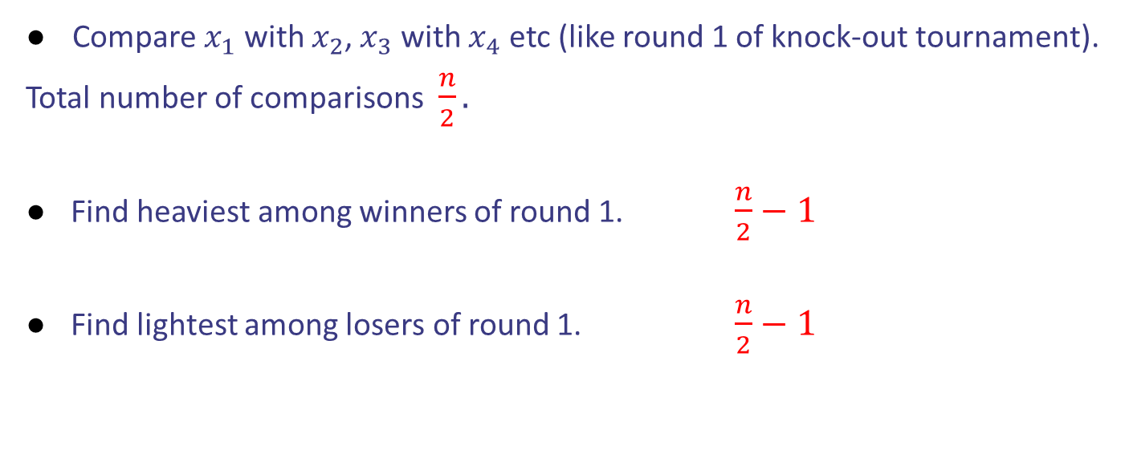
Faster approach
Compare $x_{1}$ with $x_{2}$, $x_{3}$ with $x_{4}$ etc (like round 1 of knock-out tournament).
Total number of comparisons $\frac{n}{2}.$
Find heaviest among winners of round 1. $\frac{n}{2}−1$
Find lightest among losers of round 1. $\frac{n}{2}−1$
Design and Analysis of Algorithms

Slide 40

Faster approach
Compare $x_{1}$ with $x_{2}$, $x_{3}$ with $x_{4}$ etc (like round 1 of knock-out tournament).
Total number of comparisons $\frac{n}{2}.$
Find heaviest among winners of round 1. $\frac{n}{2}−1$
Find lightest among losers of round 1. $\frac{n}{2}−1$
# comparisons $\frac{3n}{2}$ - 2
Design and Analysis of Algorithms

